Slide 1
Progress report
Zijun Yi, Xiaoben Yin
IST 707

Slide 2
Project overview
Ask a home buyer to describe their dream house, and they probably won't begin with the height of the basement ceiling or the proximity to an east-west railroad.
With 79 explanatory variables describing (almost) every aspect of residential homes in Ames, Iowa, we would be able to predict the final price of each home.

Slide 3
Dataset description
The data set we are going to use is from kaggle, Ames Housing Dataset by Dean De Cock. The dataset contains 1460 rows and 81 columns. It contains a detailed description of a house, some important columns are GrLivArea, the size of the living area, OvreallQual, the overall quality, GarageArea, garage size, etc.

Slide 4
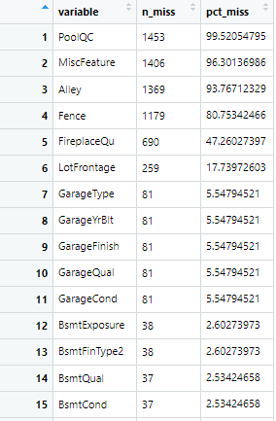
Missing values
Out of 81 columns, there are 19 columns contain missing values.
We can see from the screenshot on the left, there are four columns (PoolQC, MiscFeature, Alley, Fence) whose missing value accounts for more than 80%, and thus we decided to drop these columns.

Slide 5
Missing values
There are three different kinds of columns and we decide to use different approaches to deal with missing values in corresponding columns.
Handling the missing data in ordinal categorical variables: replacing all missing values with “No” or “Unknown”
Handling NAs in numerical variables: set all NAs to 0
Handling missing data in categorical variables: replace missing values with the most frequent value

Slide 6
Feature engineering
we decide to perform feature engineering on some columns, such as various areas.
We sum up all the areas together, and then create a new column called “TotalArea”.
We also transform some columns into dummy variables, such as whether the house was remodeled or not, whether the house was remodeled before or after the sale, and whether the house is new or not.
Last, since the target column is too large, we use log(saleprice) instead.

Slide 7

Linear Regression
In order to run Linear Regression, we need to convert all the categorical variables to numerical variables, we will be using fastDummies Packages.
Thus we will have 238 columns. Then train linear regression models with

Slide 8
Linear Regression
Results:
Residual standard error: 26120 on 214 degrees of freedom
Multiple R-squared: 0.9601, Adjusted R-squared: 0.9241
F-statistic: 26.66 on 193 and 214 DF, p-value: < 2.2e-16

Slide 9


Linear Regression
We will calculate the RMSE and R^2 of the model.

Slide 10


Random forest
For Random forest model we will be using the caret Package.
Results:
We can see the Random forest got a 0.83 R^2. Although they take a much longer time to train, this model still got a lower R squared, which is not expected.

Slide 11
Next steps
Since we have finished building the models, our next steps include: model evaluation and visualizations.
We would also keep working tuning the models, and improve on the RMSE and R^2. Perhaps increased the number of trees in Random Forest model.

Slide 12
Thank you!

